Slide 1
Common man’s investment portfolio managing system
By:
15BCB0049 Debashis Karmakar
15BCB0120 Sheril S. Philip
15BCB0107 Sammyak Rokade

Slide 2
Aim of the project
To spread awareness about investment opportunities to common man by calculating risk involved and potential returns, based on the customers risk appetite and investment corpus.

Slide 3
Abstract
Often a common person has few options with their hard earned savings. If they do not have high financial acumen then they can choose from a little more than putting their savings in the BANK as fixed deposits. Those with a little more greed tend to go to financial advisors to park their money in lucrative investments. Here too there are high chances to get conned .However there are very few who choose to analyse the market and find customized savings plans.
Our project aims to empower the common , with such financial knowledge with out an MBA.

Slide 4
Scope description
Inform the users about various financial assets classes
Take input as principle amount, risk appetite(high,low,medium) and age
Generate an investment plan depending on the above inputs
The above plans will include investment classes to be chosen , which asset should be invested in, for example, when investing in high risk high return Stock market, our system shall provide details about the stock to invest based on profitable trends, principal investment and risk involved.

Slide 5
Software TO BE USED
Tensor Flow: data generation
Google finance API
PyKnow Expert System library
Python Flask
Django DB

Slide 6

TENSOR FLOW
TensorFlow is an open-source software library for dataflow programming across a range of tasks. It is a symbolic math library, and also used for machine learning applications such as neural networks.

Slide 7
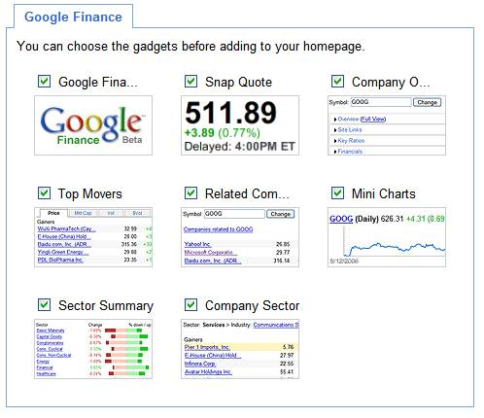
GOOGLE FINANCE API
The service features business and enterprise headlines for many corporations including their financial decisions and major news events. Stock information is available, as are Adobe Flash-based stock price charts which contain marks for major news events and corporate actions.

Slide 8
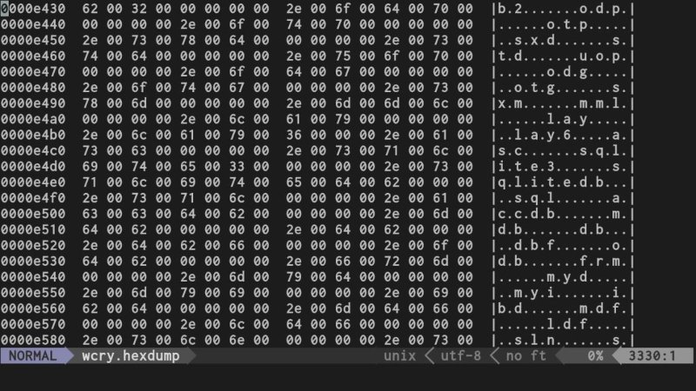
PyKnow Expert System
An expert system is a program capable of pairing up a set of facts with a set of rules to those facts, and execute some actions based on the matching rules.

Slide 9

Python FLASK
Flask is a micro web framework written in Python and based on the Werkzeug toolkit and Jinja2 template engine. It is BSD licensed

Slide 10

DJANGO
Django is a free and open-source web framework, written in Python, which follows the model-view-template (MVT) architectural pattern. It is maintained by the Django Software Foundation (DSF), an independent organization established as a non-profit.

Slide 11
Constraints/Exclusions
The system cannot always provide profitable solutions, however it shall be ensured that minimal losses are incurred.
Constraints: Time spent on this project till alpha completion is restricted to 3 and a half months

Slide 12
Assumption
Only Technical analysis is conducted by the system, fundamental analysis is not provided , that is if a war suddenly occurs and market crashes , the system can’t do much.

